Slide 1
Store Sales - Time series forecasting
CSE 523 Machine Learning Midterm project
Chakshu Pandya (AU2144001)
Darshit Pandya (AU2144003)
Dhruvin Kotak (AU2144004)
Fena Changela (AU2144005)
Mehul S Raval,
Associate Dean – Experiential Learning,
Professor, School of Engineering and Applied Science,
Ahmedabad University

Slide 2
Introduction
Time Series is a certain sequence of data observations that a system collects within specific periods of time.
Shifts and odds in dataset may include the switch of trends, seasonal spikes in demand, certain repetitive changes or non-systematic shifts in usual patterns, etc.
In this project we are going to build a machine learning model and predict the store sales using time-series forecasting.
*https://nix-united.com/blog/find-out-how-to-use-machine-learning-for-time-series-forecasting/#:~:text=So%20What%20is%20Time%20Series,daily%2C%20monthly%2C%20or%20yearly.

Slide 3
Problem Statement
To forecast store sales on data from Corporacion Favorita, a large Ecuadorian-based grocery retailer using time-series forecasting in machine learning. For solving the frequency Inventory (shortage when needed) for the product and man forces requirement when high demand is going on.
Corporacion Favorita is a supermarket company in Ecuador.
Ecuador is an oil-based country and oil price affects every product here. So, we need to correlate oil price with sales of every product, that is the reason we have to use time series in this product.

Slide 4
Data sets
Here the data sets are provided by Favorita stores located in Ecuador to predict the sales.
Oil: It contains the data of oil prices on the daily basis of the Ecuador country. Ecuador is an oil-dependent country in the south america.
Train: The train data contains, comprising time series of features “store_nbr, family and on promotion” as well as the target sales.
Store_nbr: identifies the store at which the products are sold.
Family: identifies the type of product sold.
Sales: gives the total sales for a product family at a particular store at a given date.
On Promotion: gives the total number of items in a product family that were being promoted at a store at a given date.
*Dataset is taken from https://www.kaggle.com/c/store-sales-time-series-forecasting/data

Slide 5
Data sets
Test: The test data, having the same features as the training data.
Stores: Store metadata, including city, state, type, and cluster.
cluster is a grouping of similar stores.
Holiday_Events: Holiday events includes Holidays and Events, with metadata.
*Dataset is taken from https://www.kaggle.com/c/store-sales-time-series-forecasting/data

Slide 6
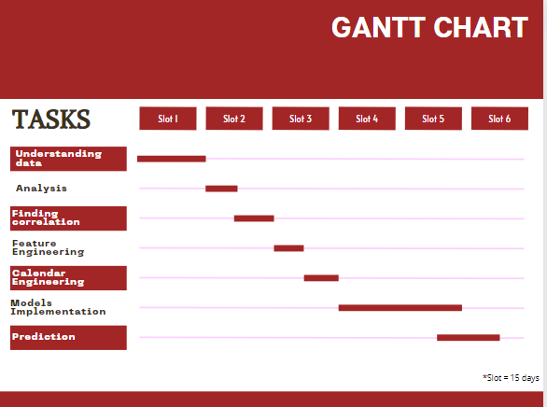

Slide 7
Approach
Finding the correlation between Sale and Public Events, oil prices (Data Analysis).
Feature Engineering
Calendar Engineering
Machine learning models implementation
Predicting the sales

Slide 8
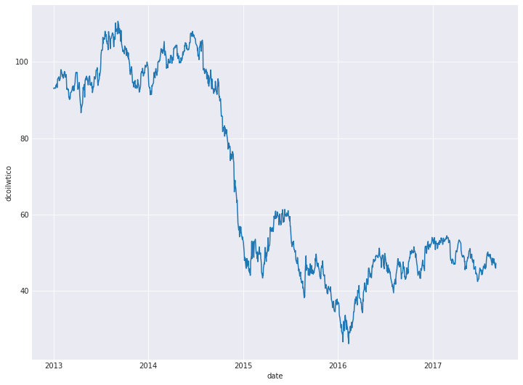
Correlation Plot
Here, we are trying to correlate all the patterns between oil price data and time series.

Slide 9
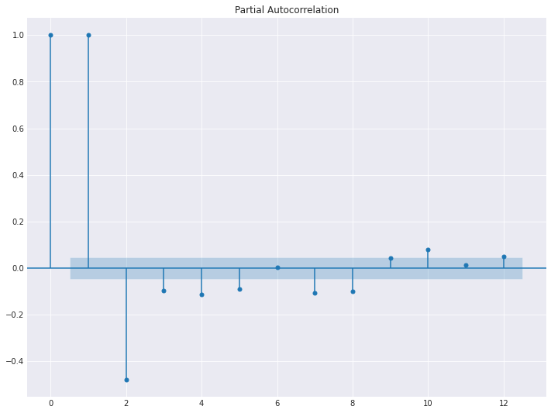
Lag Plot
A lag plot is a special type of scatter plot with the two variables (X,Y) “lagged.”
A “lag” is a fixed amount of passing time; One set of observations in a time series is plotted (lagged) against a second, later set of data. The kth lag is the time period that happened “k” time points before time

Slide 10
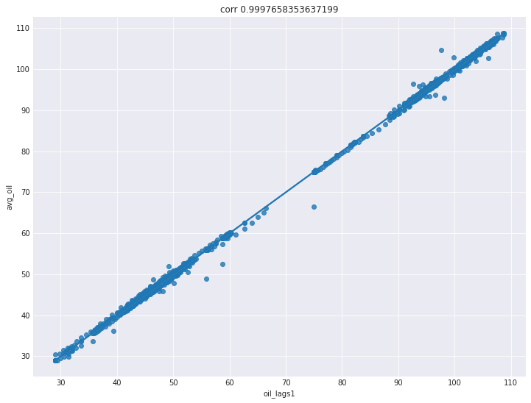
Correlation Plot

Slide 11
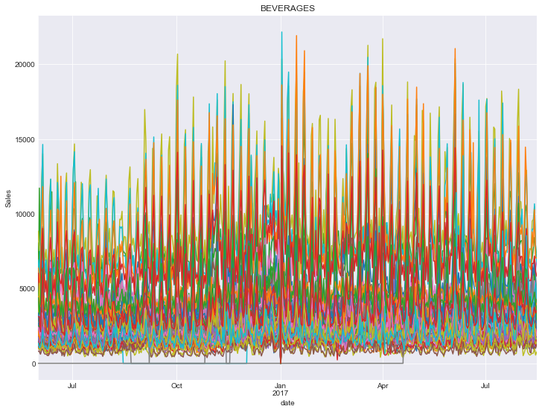
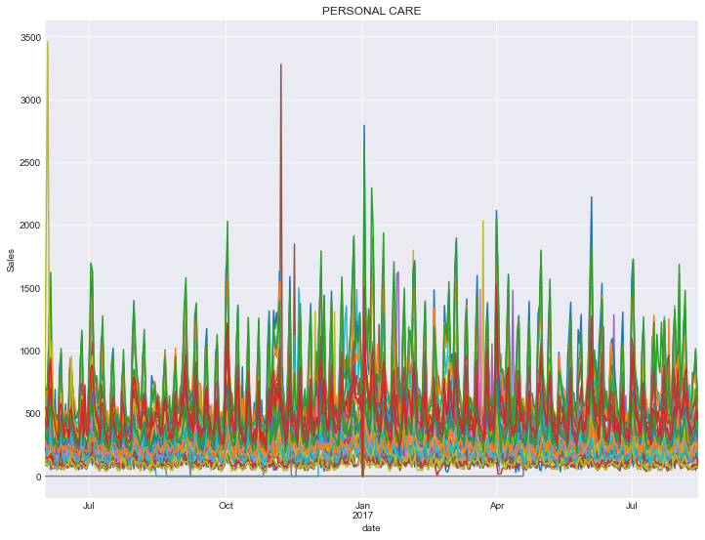

Slide 12
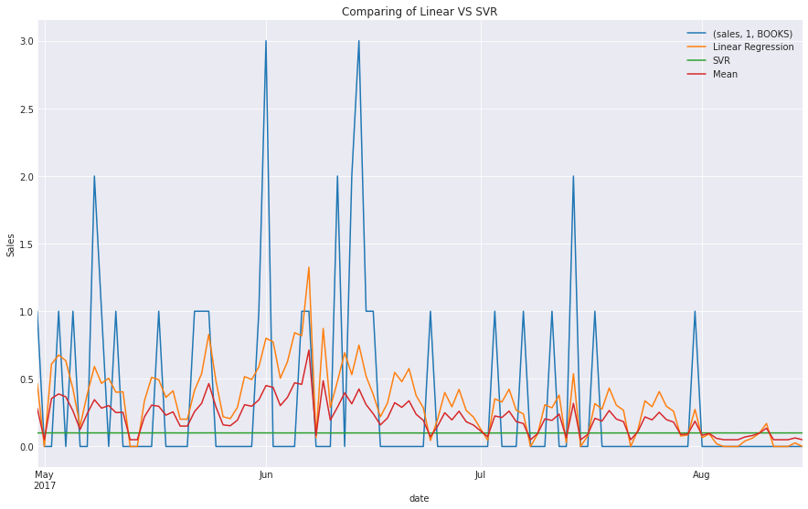
Final Results

Slide 13
RMSLE Value
Categories | Root Mean Squared Logarithmic Error
BOOKS | 0.3455
BABY CARE | 0.4857
BEVERAGES | 0.4296
DAIRY | 0.3935
HOME CARE | 0.4530
MEATS | 0.4452
PERSONAL CARE | 0.4742
PRODUCE | 0.4002
RMSLE : 0.59564183380

Slide 14
Store Sales Prediction
Store No. | Categories | Sales
1 | AUTOMOTIVE | 4.101209915
1 | BABY CARE | 0
1 | BEAUTY | 4.555176899
1 | BEVERAGES | 2262.699439
1 | BOOKS | 0.083691179
1 | BREAD/BAKERY | 376.8196113
1 | CELEBRATION | 13.12506081
1 | CLEANING | 735.4486687
1 | DAIRY | 753.1388008
1 | DELI | 131.5335143

Slide 15
Conclusion
In this project we have predicted the sales and also have find the difference between the predicted values and the actual observed values, which is called root mean square error (RMSE).
The RSMLE value in linear regression is 0.3958433835879891 and in SVR it is 0.46274117207951615. But the least root mean square error, we find in the average of both these regression, which is 0.3846102422210306.

Slide 16
References
[1] Tom M. Mitchell. Machine Learning and Data Mining. COMMUNICATIONS OF THE ACM N. 1999. url: http://www.cs.cmu.edu/~tom/pubs/cacm99_final.pdf.
[2] Matavfall i Sverige – Uppkomst och behandling 2016. Naturvårdsverket. 2018.
url: https://www.naturvardsverket.se/Documents/publikationer6400/978-91-620-8811-8.pdf?pid=22466.
[3] Coop Värmland. 2020. url: https://coopvarmland.se/vara-butiker/.
[4] Bohdan M Pavlichenko. “Machine-Learning Models for Sales Time Series Forecasting”. In: Data 4.1 (2019), p. 15. doi:10.3390/data4010015.
[5] Kasun Bandara et al. “Sales Demand Forecast in E-commerce Using a Long Short-Term Memory Neural Network Methodology”. In: Neural Information Processing Lecture Notes in Computer Science (2019), pp. 462–474. doi: 10.1007/978-3-030-36718-3_39.
[6] Ching-Wu Chu and Guoqiang Peter Zhang. “A comparative study of linear and nonlinear models for aggregate retail sales forecasting”. In: International Journal of Production Economics 86.3 (2003), pp. 217–231. doi: 10 . 1016 / s0925 -5273(03)00068-9.
[7] Zeynep Hilal Kilimci et al. “An Improved Demand Forecasting Model Using Deep Learning Approach and Proposed Decision Integration Strategy for Supply Chain”. In: Complexity 2019 (2019), pp. 1–15. doi: 10.1155/2019/9067367.
[8] Real Carbonneau, Kevin Laframboise, and Rustam Vahidov. “Application of machine learning techniques for supply chain demand forecasting”. In: European Journal of Operational Research 184.3 (2008), pp. 1140–1154. doi: 10.1016/j.ejor.2006.12.004.
[9] Indr˙e Žliobait˙e, Jorn Bakker, and Mykola Pechenizkiy. “Beating the baseline prediction in food sales: How intelligent an intelligent predictor is?” In: Expert Systems with Applications 39.1 (2012), pp. 806–815. doi: 10.1016/j.eswa.2011.07.078.

Slide 17
Thank You!

